Slide 1

Introduction to Data Science
www.BigDataTrunk.com

Slide 2
Welcome to
Introduction to Data Science
PRE-WORK
Sign-in for Attendance
Put Name on Name tag
Download Anaconda (python v3.x)
  https://www.anaconda.com/distribution/
Download material from zip in email
www.BigDataTrunk.com

Slide 3
Agenda
01
Data Science Overview
02
Data Analytics vs. DS
03
Descriptive Statistics
04
The Data Science Process
05
Python Libraries for DS
06
Next Steps

Slide 4
Logistics
Timing – 9 to 4 PM PST
Lunch – Approx. noon to 1 PM PST
Periodic Breaks – At logical points

Slide 5


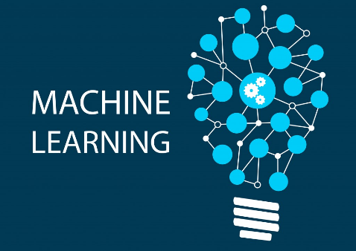








Stanford &

Slide 6
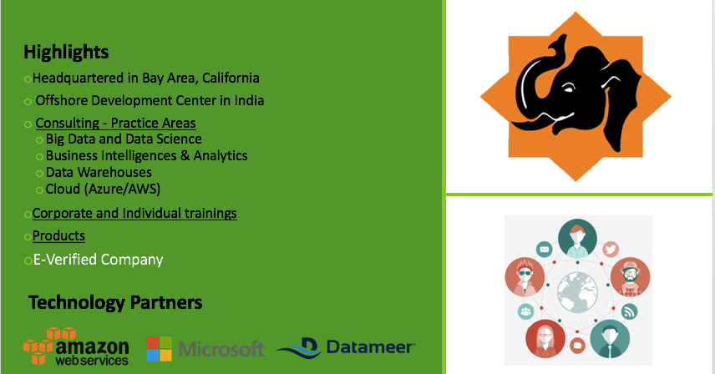
Big Data Trunk

Slide 7
Introductions

Slide 8
Hands-on Lab
Jupyter Notebook
Intro_Jupyter_Notebook.ipynb

Slide 9
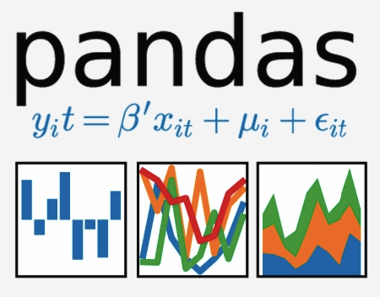




Python Libraries for Data Analysis

Slide 10
Data Science

Slide 11
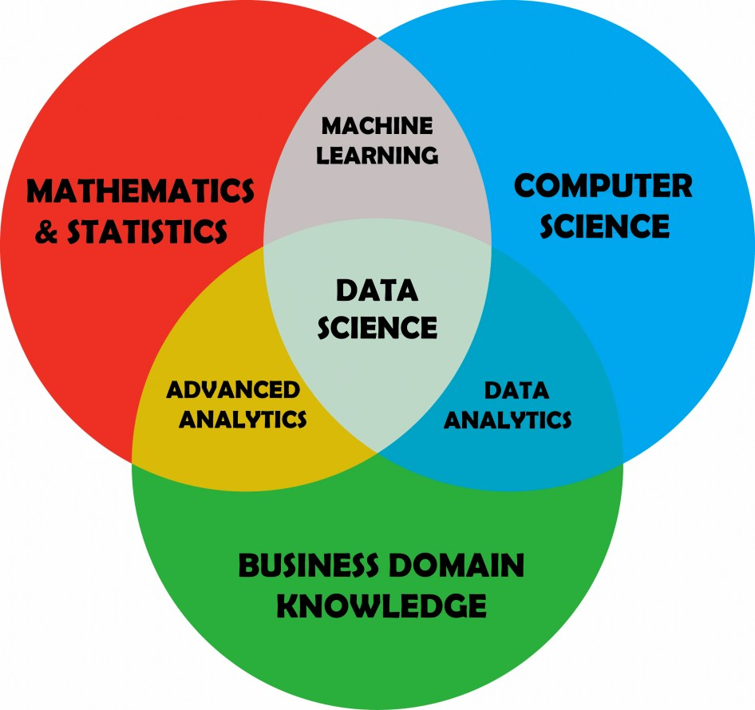
Data Science

Slide 12
Data Analytics vs. Data Science

Slide 13
Python
Hands-on Lab
Python Exercise
Python_Exercise.ipynb

Slide 14
Descriptive Statistics

Slide 15
Pandas
Hands-on Lab
Pandas Exercise
Pandas_Exercise.ipynb

Slide 16
The Data Science Process (DIAPERS)
Define Problem Statement
Ingest Data
Analyze Data
Prepare Data for ML
Evaluate Models
Refine model
Ship it

Slide 17
Define Problem Statement

Slide 18
Ask good questions:
answerable
actionable
specific
narrow

Slide 19
Ingest Data

Slide 20
Google Dataset Search
  toolbox.google.com/datasetsearch
  Kaggle
  kaggle.com/datasets
  ProPublica Data Store
  propublica.org/datastore
  World Bank Open Data
  data.worldbank.org

Slide 21
Some challenges with data
Insufficient quantity of data
Non-representative data
Poor quality of data
Irrelevant features

Slide 22
Analyze Data

Slide 23
Explore the data

Slide 24
Prepare Data

Slide 25
Evaluate Models

Slide 26
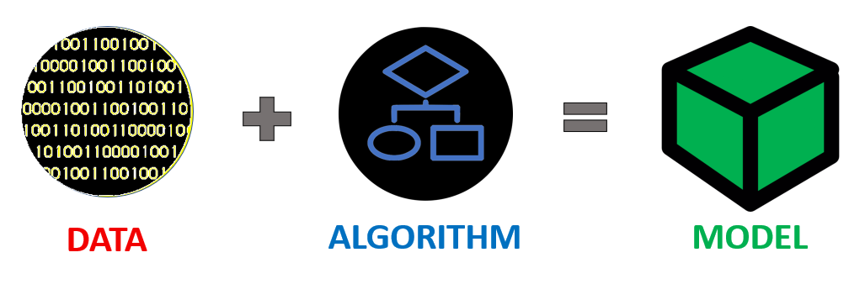
Machine Learning Model

Slide 27
Machine Learning Model

Slide 28
Machine Learning Model
.fit : learn the model
.predict : make predictions from learned model
.score : display performance metric

Slide 29
Logistic Regression | Support Vector Machine | Decision Tree | K-Nearest Neighbor | Naive Bayes
0.705 | 0.722 | 0.635 | 0.675 | 0.607

Slide 30
Survey Time
http://ttseval.stanford.edu

Slide 31
Scikit-learn
Hands-on Lab
Scikit-learn Exercise
Scikit-learn_Exercise.ipynb

Slide 32
Summary
01
Data Science Overview
02
Data Analytics vs. DS
03
Descriptive Statistics
04
The Data Science Process
05
Python Libraries for DS
06
Next Steps

Slide 33
Next steps
Make a custom plan for yourself to continue this journey
Improve some of your skills (Stats, Python, ML, Domain, etc.)
Take some additional courses
Try a Kaggle.com competition
Work on a personal project to improve understanding

Slide 34
Upcoming Course
Course | Days | Date
Fundamentals of Big Data | 1 | 8th May
Fundamentals of Python | 2 | 20-21st May
Tableau Desktop : Beginner | 1 | 11th June
Fundamentals of Data Science | 1 | 18th Jun
Tableau Desktop: Intermediate | 2 | 19-20th Jun

Slide 35
Thank you
www.BigDataTrunk.com

